Slide 1
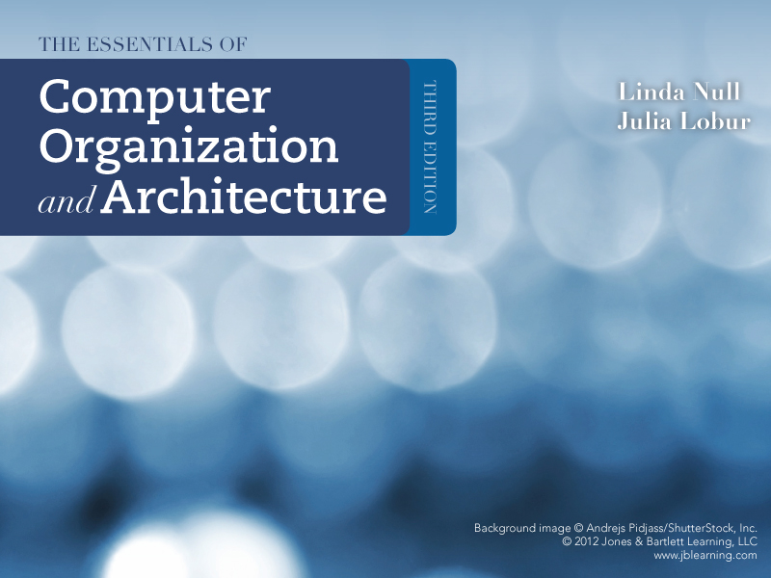
Chapter 5
A Closer Look at Instruction Set Architectures

Slide 2
Chapter 5 Objectives
Understand the factors involved in instruction set architecture design.
Gain familiarity with memory addressing modes.
Understand the concepts of instruction-level pipelining and its affect upon execution performance.

Slide 3
5.1 Introduction
We saw in Chapter 4 that machine instructions consist of opcodes and operands.
The opcodes specify the operations to be executed.
The operands specify register or memory locations of data.
In the case of using high level languages such as C, C++, or Java, should we be concerned with machine instructions?
No need for that as high level languages hide all these details (how to convert and which machine instructions are related to each high level language instruction).
However
Programmers with assembly background (solid background in computer architecture) are able to write efficient and effective programs

Slide 4
5.2 Instruction Formats
For proper design of the instruction set, a match between this set and the architecture must be established. This will ensure efficient and effective utilization of the computer hardware.
When a computer architecture is in the design phase, the instruction set format must be determined before many other decisions can be made.
Therefore, Instruction set architectures are measured according to:
Main memory space occupied by a program.
Instruction complexity (in terms of amount of decoding required and complexity of tasks being performed).
Instruction length (in bits).
Total number of instructions in the instruction set.
This how to measure of ISA quality

Slide 5
5.2 Instruction Formats
MARIE had an instruction length of 16 bits and could have at most, 1 operand.
Architectures are differentiated from one another by:
the number of bits allowed per instruction (16, 32, and 64 are the most common).
the number of operands allowed per instruction.
the types of instructions and data each can process.
More specifically, instruction sets are differentiated by the following features:
Operand storage in the CPU (data can be stored in a stack structure or in registers)
Number of explicit operands per instruction (zero, one, two, and three being the most common)
Operand location (instructions can be classified as register-to-register, register-to- memory or memory-to-memory, which simply refer to the combinations of operands allowed per instruction) (see Slide 11)
Operations (including not only types of operations but also which instructions can access memory and which cannot)
Type and size of operands (operands can be addresses, numbers, or even characters)

Slide 6
5.2 Instruction Formats
In designing an instruction set, consideration is given to:
Instruction length (whether short, long, or variable). Although short instructions are better (fetching time↓ and memory space↓), it limits the number of instructions (Opcode size ↓ as instruction length ↓, therefore, limit number of available instructions).
Moreover, fixed length instructions are easier to decode but waste memory space.
Number of operands (short instructions limit size and number of operands).
Number of addressable registers (how many registers are required).
Memory organization (whether byte or word addressable); in order to be able to access the character data.
Addressing modes (choose any or all: direct or indirect).
HOW to store data bytes in memory?

Slide 7
5.2 Instruction Formats
Choosing the best method for storing the bytes of multiple-byte data element is a debate and is called little vs big endian debate.
Since, almost all computer architectures are now byte-addressable, a standard for storing information (multiple-byte data element) is required.
Two standards exist for multiple-data element storage
Suppose we have a
2 bytes data element
Big endian machine
Storing most byte before the least byte
Ex. Most UNIX machines
Little endian machine
Storing least byte before the most byte
Ex. Most PCs
Byte 1 (Most) | Byte 0 (Least)
Moreover, most newer RISC architectures are also big endian.
Intel has always done things the Little endian way whereas, Motorola has always done things the Big endian way.

Slide 8
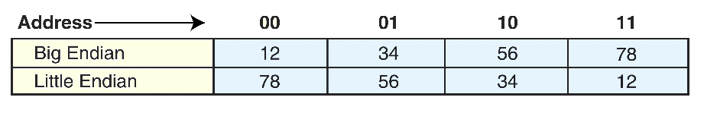
5.2 Instruction Formats
Example:
suppose we have the hexadecimal number 12345678. How to store this number using both the little and big endian
Most Significant Byte
Least Significant Byte
12 | 34 | 56 | 78
Most significant byte
Least significant byte
Least significant byte
Most significant byte
Therefore, which is the best standard to use?

Slide 9
5.2 Instruction Formats
Big endian:
More natural to most people as it is easier to be read (unlike the little endian, the order is reversed).
The sign of the number can be determined by looking at the byte at address offset 0 (unlike the little endian, the length of the data element must be known to jump to the last byte)
Strings and integers are stored in the same order (faster string operations).
Little endian:
Makes it easier to place values on non-word boundaries (allow odd addressing).
Conversion from a 32-bit integer address to a 16-bit integer address does not require any arithmetic, which makes it faster and easier (unlike the big endian, it requires addition)
Let’s see an example on this conversion

Slide 10
5.2 Instruction Formats
Example:
Suppose that we have a 32-bits integer which is: 0x23547910 and it is required to convert it to 16-bits integer. You must represent the number in both big and little endian.
Big Endian
23 | 54 | 79 | 10
10 | 79 | 54 | 23
79 | 10
Least significant 16-bits
Little Endian
10 | 79
32-bits
16-bits
16-bits
No calculation is required
Requires calculation of the least 16-bits address based on the base address
Therefore, knowing which standard is being used for manipulating data elements is very essential as it affects the software development in dealing with such data.

Slide 11
5.2 Instruction Formats
The next consideration for architecture design concerns how the CPU will store data.
Three methods can be used for data storing, which are:
A Stack architecture:
use a stack to execute instructions, and the operands are (implicitly) found on top of the stack.
Although stack-based machines have simple model for evaluation of expressions, a stack cannot be accessed randomly, which makes it difficult to generate efficient code.
An Accumulator architecture:
As in MARIE, one operand stored in the AC and that minimizes the complexity of the machine (short instructions can be used).
As many operations are based on AC, that results in high memory traffic.
General purpose register (GPR) architecture:
Uses a set of general purpose registers which are faster than memory (most widely used architecture).
Longer instructions.
This architecture reduces the PC price significantly (large number of registers can be used).
In choosing one over the other, there is a tradeoff between simplicity of hardware design (and cost) and the execution speed (and ease of use).
Note that:
If memory access is fast, a stack-based design may be a good idea;
If memory access is slow, it is often better to use registers.
These are the reasons why most computers over the past 10 years have been general register based.

Slide 12
5.2 Instruction Formats
In GPR architecture, three types of instructions can be used
Memory-memory:
May have two or three operands in memory, allowing an instruction to perform an operation without requiring any operand to be in a register
Examples: Digital Equipment’s VAX
Register-memory:
Requires a mix, where at least one operand is in a register and one is in memory
Examples: Intel and Motorola
Load-store:
require data to be moved into registers before any operations on that data are performed
Examples: SPARC, MIPS, ALPHA, and the PowerPC
NOTE that:
As all operands must be named
Using registers
Longer instructions
Longer fetch and decode times

Slide 13
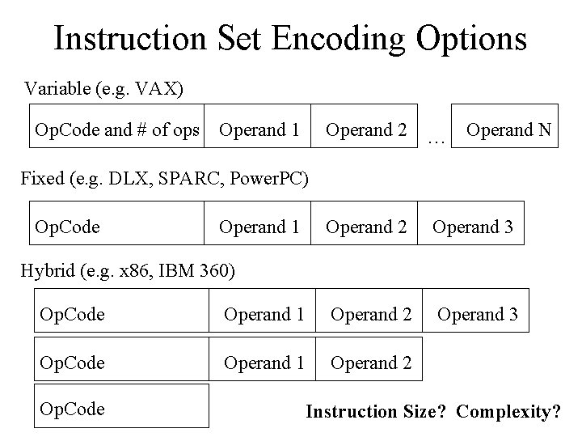
5.2 Instruction Formats
Given that most architectures today are GPR-based, we now examine two major instruction set characteristics that divide general-purpose register architectures. Those two characteristics are the number of operands and how the operands are addressed.
The traditional method for describing a computer architecture is to specify the maximum number of operands, or addresses, contained in each instruction. This has a direct impact on the length of the instruction itself.
MARIE uses a fixed length instruction with a 4-bit opcode and a 12-bit operand.
Therefore, instructions on current architectures can be formatted in two ways:
Fixed length: Wastes space but is fast and results in better performance when instruction-level pipelining is used.
Variable length: More complex to decode but saves storage space.
Fixed length (e.g. SPARC and PowerPC)
Variable length (e.g. VAX)

Slide 14
5.2 Instruction Formats
Typically, the real-life compromise involves using two to three instruction lengths, which provides bit patterns that are easily distinguishable and simple to decode.
Instruction length must be compared to the word length
Fixed instructions with length that is exactly equal to the word length, the instructions align perfectly when stored in main memory (NO waste in space)
Fixed instructions with length that are half, quarter, double, or triple the actual word size can waste of space.
Variable length instructions are clearly not the same size and need to be word aligned, resulting in waste of space as well

Slide 15
5.2 Instruction Formats
The most common instruction formats include zero, one, two, or three operands.
Arithmetic and logic operations typically have two operands, but can be executed with one operand (as we saw in MARIE), if the accumulator is implicit.
The following are some common instruction formats:
OPCODE only (zero addresses)
OPCODE + 1 Address (usually a memory address)
OPCODE + 2 Addresses (usually registers, or one register and one memory address)
OPCODE + 3 Addresses (usually registers, or combinations of registers and memory addresses)
All architectures have a limit on the maximum number of operands allowed per instruction. For example, in MARIE, the maximum is one, although some instructions had no operands (Halt and Skipcond).

Slide 16
5.2 Instruction Formats
One of the important data structures in machine architecture is the Stack. As it can be used in executing the machine instructions (as previously mentioned).
Stack not only provides an efficient mean of storing intermediate data values during complex calculations, but it also provides an efficient method for passing parameters during procedure calls as well as a mean to save local block structure and define the scope of variables and subroutines. (e.g JnS in MARIE)
In architectures based on stacks, most instructions consist of opcodes only. However, TWO important one-operand instructions are required to deal with the stack which are:
Push X places the data value found at memory location X onto the stack. Pop X removes the top element in the stack and stores it at location X.
Only certain instructions are allowed to access memory (such as load/store); all others must use the stack for any operands required during execution.

Slide 17

5.2 Instruction Formats
For operations requiring two operands, the top two elements of the stack are used. For example, if we execute an Add instruction, the CPU adds the top two elements of the stack, popping them both and then pushing the sum onto the top of the stack.
4 2 +
2
6
4
The stack organization is very effective for evaluating long arithmetic expressions. This representation places the operator after the operands in what is known as postfix notation (as compared to infix notation, which places the operator between operands, and prefix notation, which places the operator before the operands).

Slide 18
5.2 Instruction Formats
Stack architectures require us to think about arithmetic expressions a little differently.
We are accustomed to writing expressions using infix notation, such as: Z = X + Y
Stack arithmetic requires that we use postfix notation:
Z = XY+
This is also called Reverse Polish Notation (RPN), in honor of its Polish inventor, Jan Lukasiewicz (1878 - 1956).
The principal advantage of postfix notation is that parentheses are not used.
For example:
Becomes
Z = (X + Y) × (W + U)
Z = X Y + W U + ×
Using infix notations
Using postfix notations

Slide 19
5.2 Instruction Formats
Example: Convert the infix expression (2+3) - 6/3 to postfix.
The sum 2 + 3 in parentheses takes precedence; we replace the term with 2 3 +.
2 3+ - 6/3
2 3+ - 6 3/
The division operator takes next precedence; we replace 6/3 with 6 3 /.
The quotient 6/3 is subtracted from the sum of 2 + 3, so we move the - operator to the end.
2 3+ 6 3/ -

Slide 20
5.2 Instruction Formats
Example: Use a stack to evaluate the postfix expression 2 3 + 6 3 / -
2
3
+
6
3
/
-
Scanning the expression from left to right, push operands onto the stack, until an operator is found
Pop the two operands and carry out the operation indicated by the operator. Push the result back on the stack.
2
5
3
The answer is at the top of the stack.
Stack

Slide 21
5.2 Instruction Formats
*
Suppose we have the expression:
Z = X × Y + W × U
Let's see how to evaluate an infix expression using different instruction formats.
Using three-address ISA (e.g. mainframes)
Using two-address ISA
(e.g. INTEL and Motorola)
Using one-address ISA (e.g. MARIE)
MULT R1,X,Y
MULT R2,W,U
ADD Z,R1,R2
LOAD R1,X
MULT R1,Y
LOAD R2,W
MULT R2,U
ADD R1,R2
STORE Z,R1
LOAD X
MULT Y
STORE TEMP
LOAD W
MULT U
ADD TEMP
STORE Z
Note: One-address ISAs usually require one operand to be a register.

Slide 22
5.2 Instruction Formats
In a stack ISA, the postfix expression,
Z = X Y × W U × +
might look like this:
Would this program require more execution time than the corresponding (shorter) program that we saw in the 3-address ISA?
PUSH X
PUSH Y
MULT
PUSH W
PUSH U
MULT
ADD
PUSH Z
Computing Z=(X x Y) + (W x U) | Computing Z=(X x Y) + (W x U)
 | GPR 3 Operands | GPR 2 Operands | MARIE 1 Operand | Stack based instructions
No. of Instructions | 3 | 6 | 7 | 8
The stack ISA require the longest execution time

Slide 23

5.2 Instruction Formats
We have seen how instruction length is affected by the number of operands supported by the ISA.
In any instruction set, not all instructions require the same number of operands.
Operations that require no operands, such as HALT, necessarily waste some space when fixed-length instructions are used.
Then, how to solve this problem?
One way to recover some of this space is to use expanding opcodes.

Slide 24
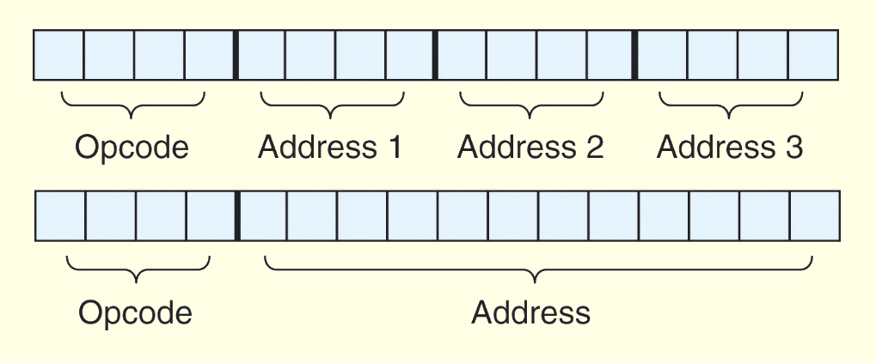
5.2 Instruction Formats
Expanding opcodes:
Expanding opcodes represent a compromise between the need for a rich set of opcodes and the desire to have short opcodes, and thus short instructions.
Large set of instructions is needed
Long opcode bits to encode such instructions
Too complex to be decoded
Therefore, a compromise between the number of instructions available and the instruction length is essential.
A system has 16 registers and 4K of memory.
If the system uses 16-bit instructions, then two choices for our instructions are available:
4 bits are required to access each register
12 bits are required to access each memory location

Slide 25

5.2 Instruction Formats
Expanding opcodes:
Expanding opcodes represent a compromise between the need for a rich set of opcodes and the desire to have short opcodes, and thus short instructions.
The idea is to make short opcode for easier processing but still have the ability to extend this opcode for larger number of instructions in the case of fewer number of operands.
In other words, there are longer opcodes with fewer operands as well as shorter opcodes with more operands
Suppose we wish to encode the following instructions:
• 15 instructions with 3 addresses
• 14 instructions with 2 addresses
• 31 instructions with 1 address
• 16 instructions with 0 addresses
Can we encode this instruction set using 16 bits?

Slide 26
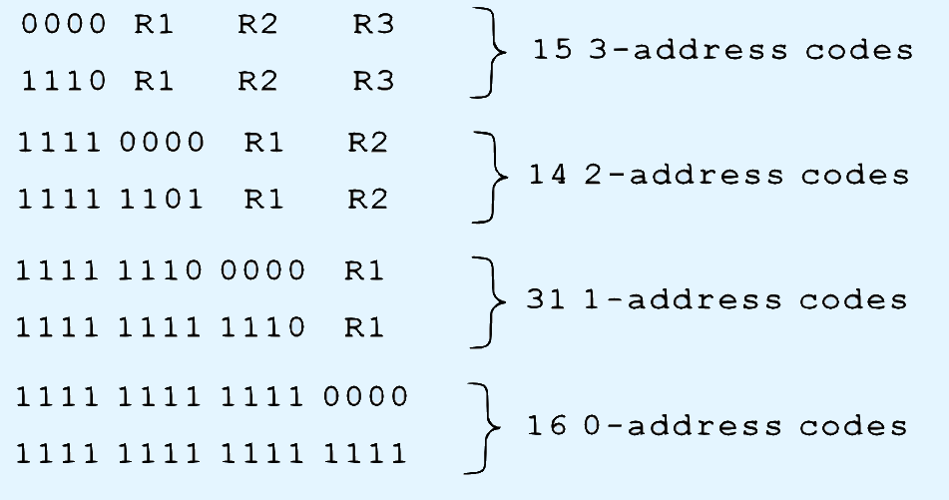
5.2 Instruction Formats
The answer is yes, as long as we use expanding opcodes. The encoding is as follows:
Can we extend the number of 3-address instruction to 16 instead of 15?
0-14 opcodes with 3 registers
0-13 opcodes with 2 registers
0-30 opcodes with 1 register
0-15 opcodes with 0 register
Since, the opcode bits are not fixed (extended opcode), a more complex operations are required to decode these instructions.
HOW?

Slide 27
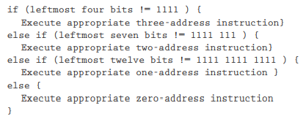
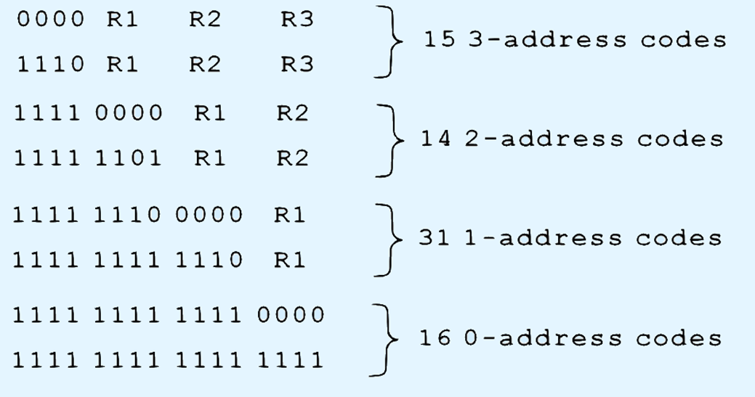
5.2 Instruction Formats
Instead of looking at a bit pattern and deciding which instruction it is, we need to decode the instruction such as follows:

Slide 28
5.2 Instruction Formats
TEST Your Self
Example: Given 8-bit instructions, is it possible to allow the following to be encoded?
3 instructions with two 3-bit operands.
2 instructions with one 4-bit operand.
4 instructions with one 3-bit operand.
See Examples 5.9 and 5.10 in the Textbook
The bit patterns required for each category are:
For the 3 instructions with two 3-bit operands - 3 × 23 × 23 = 192 bit patterns
For the 2 instructions with one 4-bit operand - 2 × 24 = 32 bit patterns
For the 4 instructions with one 3-bit operand - 4 × 23 = 32 bit patterns
The total bit patterns required are 256 bit patterns
Therefore, to be able to have 256 different patterns 8 bits are required (256=28)
Assumption is TRUE
One such encoding is shown on the next slide

Slide 29
5.2 Instruction Formats
TEST Your Self
3 instructions with two 3-bit operands
2 instructions with one 4-bit operand
4 instructions with one 3-bit operand
0 | 0 |  | X | X | X |  | X | X | X
0 | 1 |  | X | X | X |  | X | X | X
1 | 0 |  | X | X | X |  | X | X | X
1 | 1 | 0 | 0 |  | X | X | X | X
1 | 1 | 0 | 1 |  | X | X | X | X
1 | 1 | 1 | 0 | 0 |  | X | X | X
1 | 1 | 1 | 0 | 1 |  | X | X | X
1 | 1 | 1 | 1 | 0 |  | X | X | X
1 | 1 | 1 | 1 | 1 |  | X | X | X
If (leftmost two bits != 11)
Execute appropriate two 3-bit address instruction
else if (leftmost three bits != 111)
Execute appropriate one 4-bit address instruction
else
Execute appropriate one 3-bit address instruction

Slide 30
5.3 Instruction types
Instructions fall into several broad categories that you should be familiar with:
Data movement (memory to register, register to register, and register to memory).
Arithmetic (Add, Subtract, …..).
Boolean (AND, OR, …..).
Bit manipulation (shift, rotate, …).
I/O (transferring from or to a device or port).
Control transfer (Skip, Jump, JnS, …).
Special purpose (any other operations).

Slide 31
5.4 Addressing
Addressing modes specify where an operand is located.
They can specify a constant, a register, or a memory location.
The actual location of an operand is its effective address.
Certain addressing modes allow us to determine the address of an operand dynamically.
The 12-bit of the MARIE instruction can be interpreted in many way, thus providing us with several different addressing modes.
Addressing Modes
Immediate addressing is where the data is part of the instruction.
Direct addressing is where the address of the data is given in the instruction.
Register addressing is where the data is located in a register.
Indirect addressing gives the address of the address of the data in the instruction.
Register indirect addressing uses a register to store the address of the address of the data.

Slide 32
5.4 Addressing
Indexed addressing uses a register (implicitly or explicitly) as an offset, which is added to the address in the operand to determine the effective address of the data. (e.g. address X and the index register hold 1, then effective address is X+1)
Based addressing is similar as indexed addressing except that a base register is used instead of an index register.
The difference between these two is that an index register holds an offset relative to the address given in the instruction, a base register holds a base address where the address field represents a displacement from this base.
In stack addressing the operand is assumed to be on top of the stack.
There are many variations to these addressing modes including:
Indirect indexed (uses indirect and indexed addressing)
Base/offset (adds an offset to a specific base register)
Self-relative (computes the address as an offset from current instruction)
Auto increment/decrement (automatically increment or decrement the register containing address)
Let’s look at an example of the principal addressing modes.

Slide 33
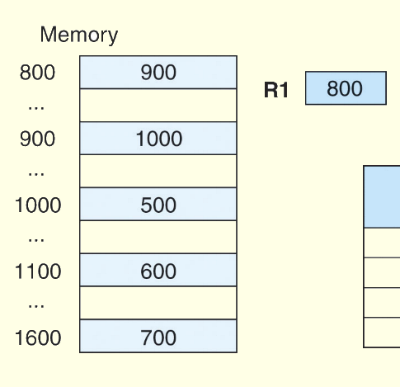
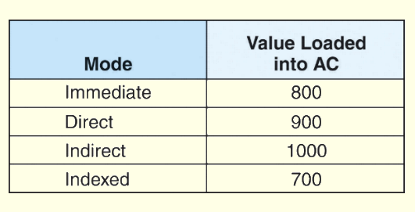
5.4 Addressing
For the instruction shown, what value is loaded into the accumulator for each addressing mode?
Load 800
These are the values loaded into the accumulator for each addressing mode

Slide 34
5.5 Instruction Pipelining
Some CPUs divide the fetch-decode-execute cycle into smaller steps.
These smaller steps can often be executed in parallel to increase throughput of the PC. This method is used by all current CPUs.
Such parallel execution is called instruction pipelining.
Instruction pipelining is used to exploit the instruction level parallelism (ILP)
The next slide shows an example of instruction pipelining

Slide 35
5.5 Instruction Pipelining
Instruction pipelining is analogous to the automobile assembly line. Each stage in this line consists of a number of parallel processes and each stage is dependent on the output of the previous stage.
Our goal always is to balance the execution time of each pipelining stage with other pipelining stages to be more or less the same.
Example: (Laundry Machine)
Knowing that each stage contains multiple processes that are carried out in parallel
Washing stage
Drying stage
Folding stage
Time of execution
Time of execution
Time of execution
These times should be equal in order to minimize waiting time between stages

Slide 36
5.5 Instruction Pipelining
Suppose a fetch-decode-execute cycle were broken into the following smaller steps:
1. Fetch instruction. 4. Fetch operands.
2. Decode opcode. 5. Execute instruction.
3. Calculate effective address of operands. 6. Store result.
Suppose we have a six-stage pipeline.
S1 fetches the instruction,
S2 decodes it,
S3 determines the address of the operands,
S4 fetches them,
S5 executes the instruction,
S6 stores the result.

Slide 37
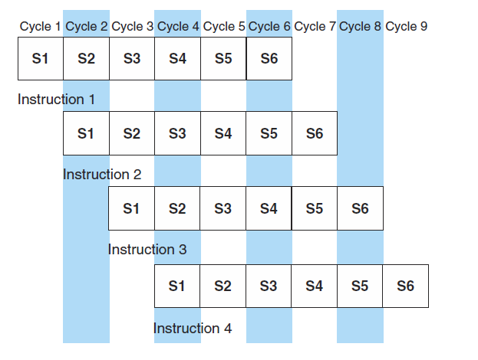
5.5 Instruction Pipelining
For every clock cycle, one small step is carried out, and the stages are overlapped.
The Figure depicts the following:
Once instruction 1 has been fetched and is in the process of being decoded, then we can start the fetch on instruction 2.
When calculating the effective address of instruction 1 operands, and instruction 2 is being decoded, then we can start fetching instruction 3.
Notice these events can occur in parallel, very much like an automobile assembly line.
S1. Fetch instruction. S4. Fetch operands.
S2. Decode opcode. S5. Execute instruction.
S3. Calculate effective address of operands. S6. Store result.

Slide 38


5.5 Instruction Pipelining
Suppose we have a k-stage pipeline. Assume that the clock cycle time is t_{p} ; that is, it takes t_{p} time per stage
S₁ | S₂ | S₃ | ……… | S_{k}
t_{p}
Assume also that we have n instructions (often called tasks) to process. Task 1 (T1) requires k × t_{p} time to be completed.
Based on the pipelining principle, each of the remaining (n-1) tasks requires only 1 t_{p} to be completed. Therefore, all the remaining tasks requires (n-1) x t_{p} time.
Hence, the total time required to complete (n) tasks is:
Total time = k x t_{p} + (n-1) x t_{p}
= (k + n – 1) x t_{p}
Let’s calculate the speedup we gain using a pipeline
Then, as n → ∞, the denominator of the equation ( k + n – 1 ) will tends to be ( n ).
Which is the number of stages in the pipeline.

Slide 39
5.5 Instruction Pipelining
The previous equation suppose only the ideal case which may be not TRUE all the time. Two assumptions were used in our derivation, which are:
First, we have to assume that the architecture supports fetching instructions and data in parallel (Harvard model). Instead of Harvard model, the use of instruction cache can solve this problem.
Second, we assume that the pipeline can be kept filled at all times. This is not always the case. Pipeline hazards arise that cause pipeline such as: conflicts.
An instruction pipeline may be flushed for any of the following reasons:
Resource conflicts.
Data dependencies.
Conditional branching.
See the next slide for an example of Conditional Branching

Slide 40
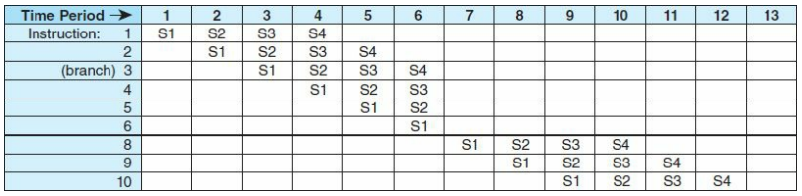
5.5 Instruction Pipelining
Example: Suppose that we a 4-stages pipeline, which are as follows:
S1 = fetch instruction
S2 = decode and calculate effective address
S3 = fetch operand
S4 = execute instruction and store results
After executing Instruction 3, at time period 6, the stages executed for I4, I5, and I6 are no longer needed and the pipeline is flushed and it starts to be filled with I8, I9, and I10.
Also, only one instruction was executed within the period from 6 to 9.
Also, only one instruction was executed within the period from 6 to 9.

Slide 41
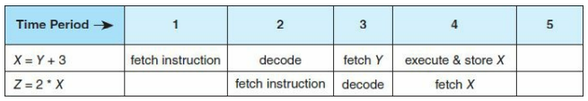
5.5 Instruction Pipelining
Resource conflicts:
Accessing the same resource simultaneously from TWO sources. if one instruction is storing a value to memory while another is being fetched from memory, both need access to memory. Typically this is resolved by allowing the instruction execute to continue, while forcing the instruction fetch to wait.
Data dependencies
Arise when the result of one instruction, not yet available, is to be used as an operand to a following instruction.
X = Y + 3 and Z = 2 * X
The value of (X) will not be available to be fetched.
Conditional branching
If instructions are fetched one per clock cycle, several can be fetched and even decoded before a preceding instruction, indicating a branch, is executed. Conditional branching is particularly difficult to deal with.
Measures can be taken at the software level as well as at the hardware level to reduce the effects of these hazards, but they cannot be totally eliminated.

Slide 42
Chapter 5 Conclusion
ISAs are distinguished according to their bits per instruction, number of operands per instruction, operand location and types and sizes of operands.
Endianness as another major architectural consideration.
CPU can store store data based on
1. A stack architecture
2. An accumulator architecture
3. A general purpose register architecture.

Slide 43
Chapter 5 Conclusion
Instructions can be fixed length or variable length.
To enrich the instruction set for a fixed length instruction set, expanding opcodes can be used.
The addressing mode of an ISA is also another important factor. We looked at:
Immediate – Direct
Register – Register Indirect
Indirect – Indexed
Based – Stack

Slide 44
Chapter 5 Conclusion
A k-stage pipeline can theoretically produce execution speedup of k as compared to a non-pipelined machine.
Pipeline hazards such as resource conflicts and conditional branching prevents this speedup from being achieved in practice.
The Intel, MIPS, and JVM architectures provide good examples of the concepts presented in this chapter.

Slide 45
End of Chapter 5

